Slide 1
Internetworking with TCP/IP
Lecture 2: Internet Protocol IPv4
Dr. Nazrul Islam
Associate Professor
Department of Information and Communication Technology (ICT)
Mawlana Bhashani Science and Technology University
Tangail-1902, Bangladesh.
Notes:
1

Slide 2
Outline
Introduction
Internetworking Issues
IPv4
Service Model
IPv4 Datagram Format
IP Service Primitives
IPv4 Addressing
Classless Addressing
Subnetting and Supernetting
Datagram Delivery
Finding the Local Router
Routers
ICMPv4
Address Translation
Datagram Delivery
2

Slide 3
Introduction
Definition Internetworking
Interconnection of multiple networks into an Internet
Task: getting packets from the source to destination
In order to achieve the goal, one needs to
Have knowledge about the topology of the network and also about the network itself
Be able to select appropriate path through the network
Select routes to avoid congestion
Be able provide internetworking when the source and destination are in different networks
Some definitions
Data Terminal Equipment (DTE): End System (ES) or Host
Data Communication System (DCS)
Internetwork (or Internet): composite network being used (e.g., LAN/WAN/LAN)
Subnetwork: constituent network of the Internet (e.g., LAN)
Intermediate System (IS) or Interworking Unit (IWU): device that interconnects two networks (e.g., bridge, router, gateway)
3

Slide 4
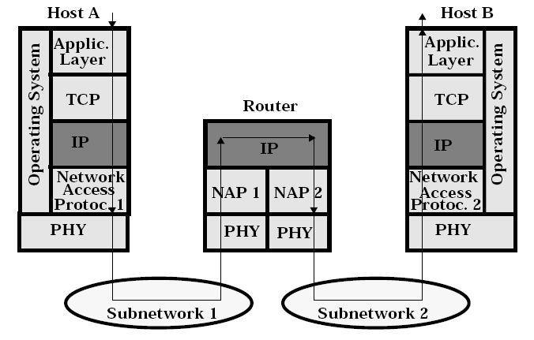
Interworking Issues
Functions
TCP: e2e error and flow control
IP: routing and forwarding
NAP: forwarding (only within subnetwork); point-to-point error and flow control;
4

Slide 5
Internetworking Issues (cont)
Some of the most important issues
Overall requirements
Services provided to transport layer
Naming
Addressing
Routing
Internetworking
Quality of Service (eventually)
Maximum packet size
Flow and error control (at DLL and TL only; not at IP)
Congestion control
Error reporting
Network layer structure
Architectural approaches
…
5

Slide 6
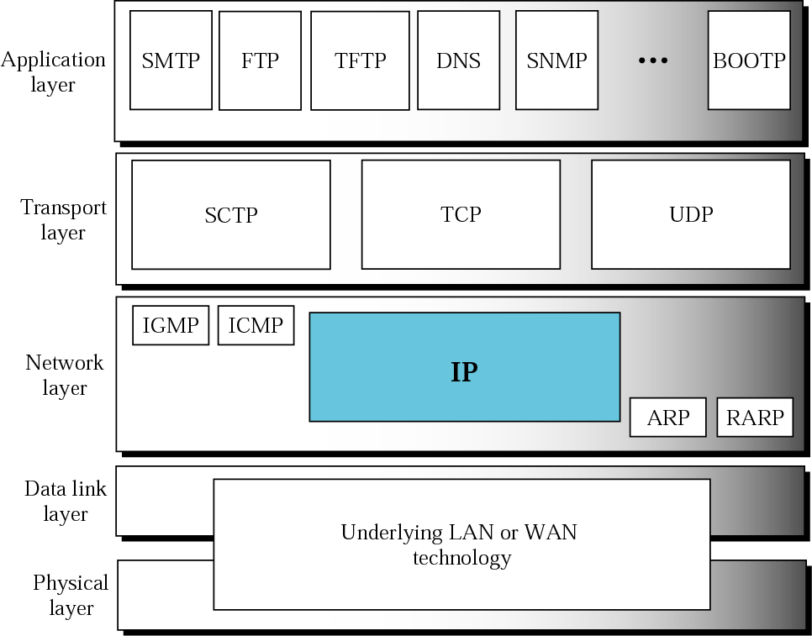
Interworking Issues (cont)
Fig 7.1 – Forouzan 4th edition
6

Slide 7
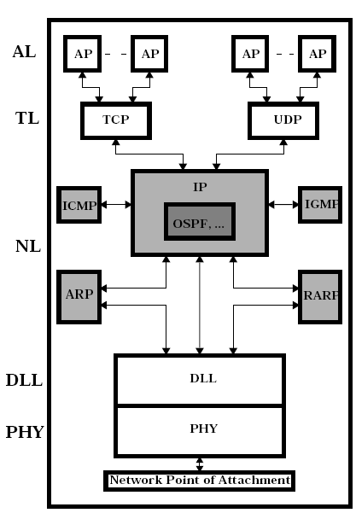
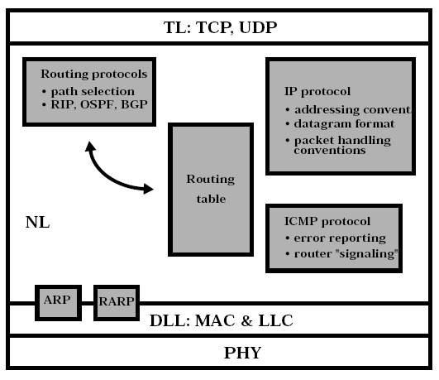
Internetworking Issues (cont)
Internet network layer
IP adjunct protocols
7

Slide 8
IPv4
Two main components
IP services (IP to/from TCP/UDP)
Protocol format and mechanisms
Aspects considered
Service model
IPv4 datagram format
IP service primitives
IPv4 addressing
Subnets and subnet masks
Special purpose addresses
Segmentation and reassembly
ICMPv4
Address translation
Finding the local router
Datagram delivery
Generic router architecture
Important addresses
RFC editor homepage http://www.rfc-editor.org
RFC hypertext archive http://rfc.dotsrc.org/
InterNIC (Internet Domain Name Registration Services) http://www.internic.net/
IANA (Internet Assigned Numbers Authority) http://www.iana.org
ICANN (Internet Cooperation for Assigned Names and Numbers) http://www.icann.org
8

Slide 9
Service Model
IP service model
Best-effort, connectionless service, i.e., no guarantees, only datagram delivery
Main components
Addressing scheme
Datagram model of data delivery
Main IP Specs
IPv4: RFC 791 (1981)
ICMP: RFC 792 (1981)
ARP (Ethernet): RFC 826, 1027 (1982)
RARP (Ethernet): RFC 903 (1982)
ARP/RARP
There are more versions ARP/RARP, depending upon the network below
ARP cache: contain address mappings IP address vs. PHY address
9

Slide 10
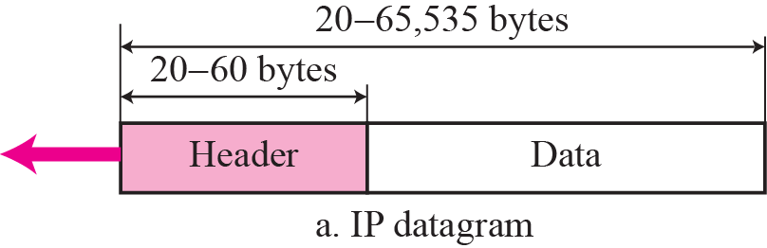
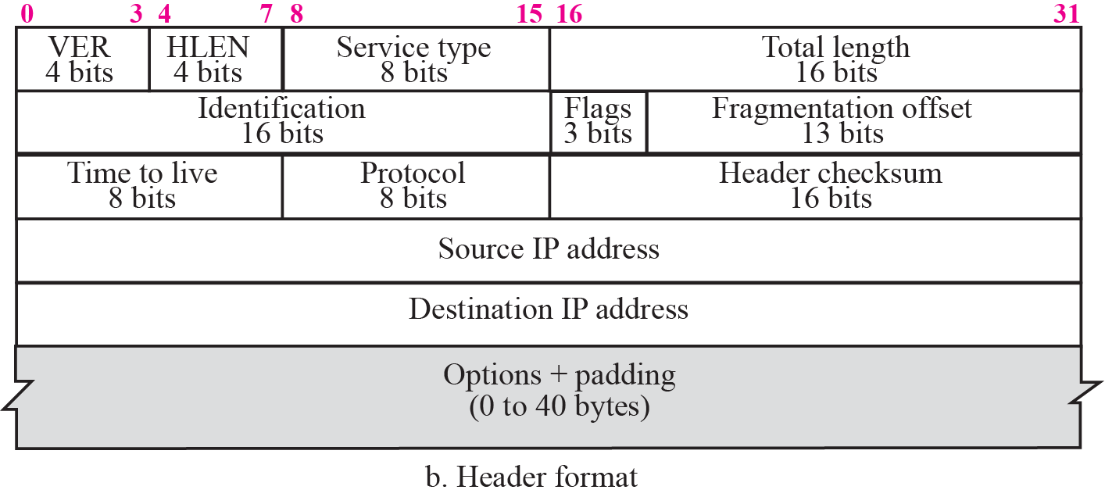
IPv4 Datagram Format
Fig 7.2 – Forouzan 4th edition
10

Slide 11
IPv4 Datagram Format (cont)
Version (4 bits): indicates protocol version number (IPv4; IPv6)
Header Length (HLEN – 4 bits): length of header in 32-bit words
Differentiated Services (DS), previously called Service Type (ST)
DS: first 6 bits make up the code point subfield, and the last 2 bits are not used
ST: first 3 bits are called “Precedence” bits, the next 4 bits are called “Type of Service (ToS)” and the last bit is not used
Total Length (16 bits): total datagram length, including the header (max 65,535 bytes)
Identification (16 bits): used to manage the segmentation/reassembly process
Flags (3 bits): only two bits (“More” and “Don’t Fragment”) are currently used to manage the segmentation/reassembly process
Fragment Offset (13 bits): indicates position where in the original datagram the specific fragment belongs; measured in 64-bit units
Time to Live (8 bits): TTL specifies how long (in sec), a datagram is allowed to remain in the Internet; decreased each time the datagram passes a router (1 sec/router)
Protocol (8 bits): indicates the higher layer protocol to received the data field (at destination) – RFC 1700
Header Checksum (16 bits): an error-detecting code is applied in the IP header only; this code is verified and recomputed at every router
Source Address (32 bits): to allow a variable number of bits to specify the network (and the subnetwork) and the host address of the transmitting host
Destination address (32 bits): to allow a variable number of bits to specify the network (and the subnetwork) and the host address of the receiving host
Options (variable): rarely used today, it allows an IP header to be extended with diverse options, e.g., security, source routing, route recording, stream identification; time stamping
Padding (variable): used to ensure that the datagram header has a length that is multiple of 32 bits
Data (variable): must have a length that is an integer multiple of 8 bits; maximum length is 65,536 octets
11

Slide 12
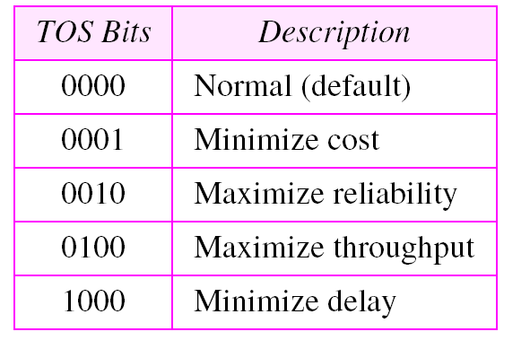
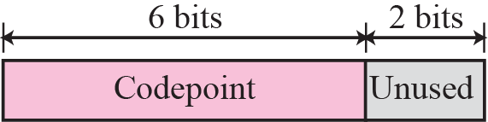
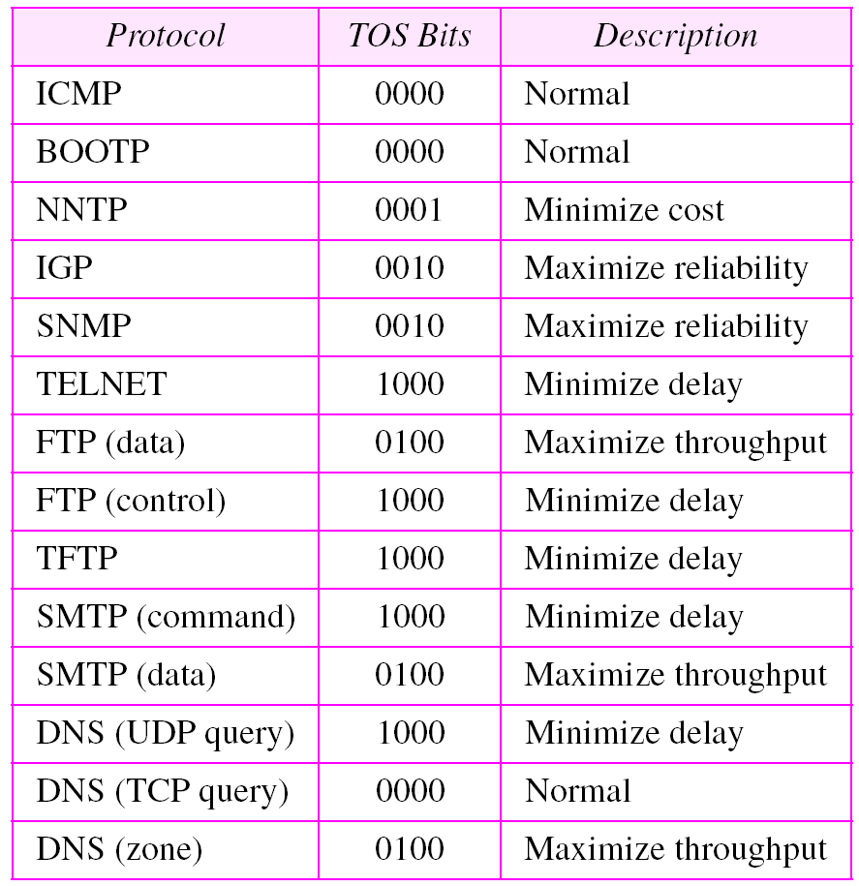
IPv4 Datagram Format (cont)
Table 8.1 – Forouzan 3rd edition
Fig 7.3 – Forouzan 4th edition
Service Type
Table 8.2 – Forouzan 3rd edition
12

Slide 13
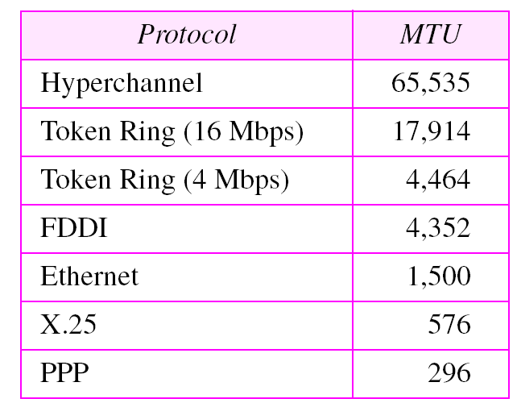
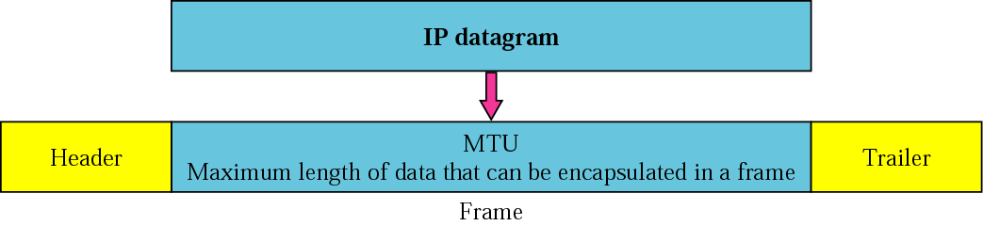
IPv4 Datagram Format (cont)
Fig 7.6 – Forouzan 4th edition
Table 8.5 – Forouzan 3rd edition
Datagram Maximum Transfer Unit
13

Slide 14
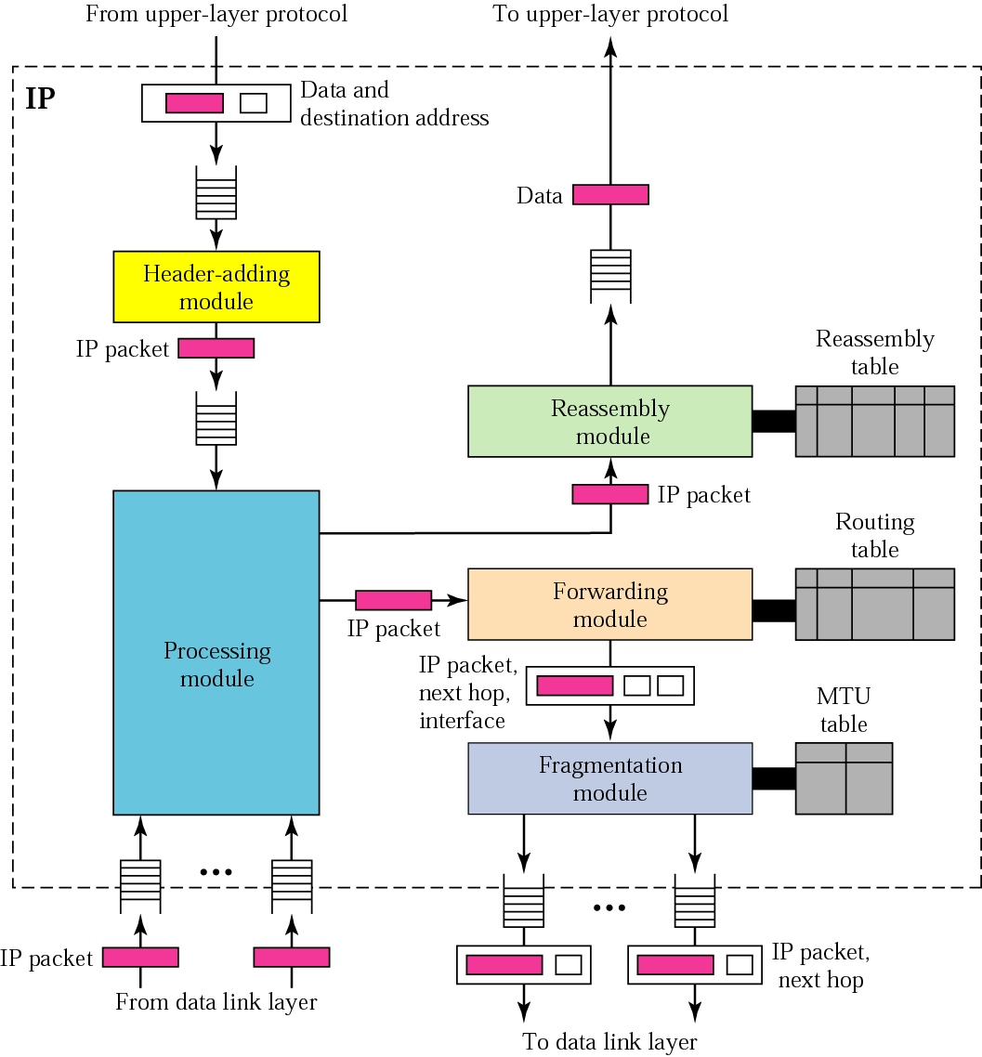
IPv4 Datagram Format (cont)
Fig 7.29 – Forouzan 4th edition
IP components
14

Slide 15
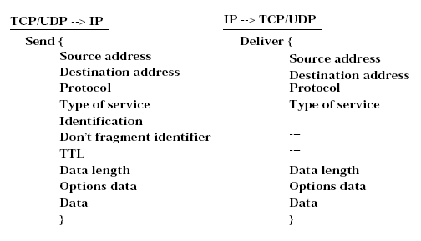
IP Service Primitives
15

Slide 16
IPv4 Addressing
An IP address is a 32-bit address that uniquely and universally defines the connection of a host or a router to the Internet
IP addresses are unique in the sense that each address defines one, and only one, connection to the Internet
The address space of IPv4 is 2³² or 4,294,967,296
Two categories of IP addressing
Classful addressing
Classless addressing
16

Slide 17
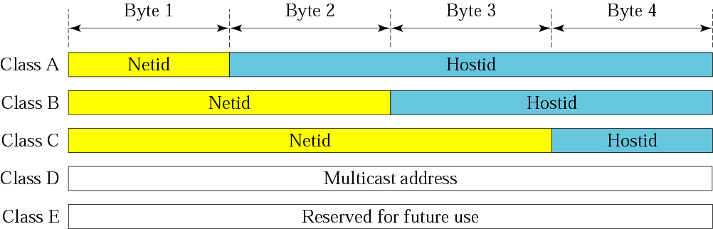
IPv4 Addressing (cont)
Class A: 1.0.0.0 to 127.255.255.255 (7 bits for Netid and 24 bits for Hostid; 126 network addresses: 1 – 126; 0 and 127 are reserved; max 16,777,214 hosts/net)
Class B: 128.0.0.0 to 191.255.255.255 (14 bits for Netid and 16 bits for Hostid; 2¹⁴ = 16,384 network addresses; max 65,534 hosts/net)
Class C: 192.0.0.0 to 223.255.255.255 (21 bits for Netid and 8 bits for Hostid; 221 = 2,097,152 network addresses; max 255 hosts/net)
Class D: 224.0.0.0 to 239.255.255.255 (228 network addresses) [RFC 1112]
Class E: 240.0.0.0 to 247.255.255.255
Special addresses
0.0.0.0 – some unknown host (booting purposes)
10.0.0.1 – ARPA NIC (old)
127.0.0.0 – this host (local loop)
255.255.255.255 – any host (broadcast purposes)
A.255.255.255 – direct broadcast (class A)
B.B.255.255 – direct broadcast (class B)
C.C.C.255 – direct broadcast (class C)
Address format: Prefix/Network/Host
Dotted decimal representation: xxx.yyy.zzz.vvv (x, y, z and v between 0 and 9)
Netid and hostid
Fig 5.8 – Forouzan 4th edition
17

Slide 18
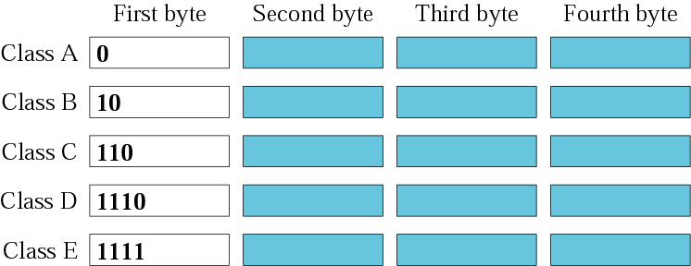
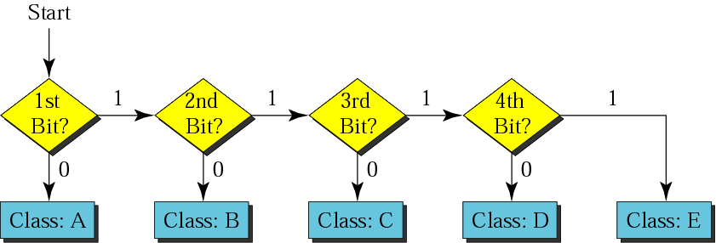
IPv4 Addressing (cont)
Finding the class in binary notation
Finding the address class
Fig 5.6 – Forouzan 4th edition
Fig 5.7 – Forouzan 4th edition
18

Slide 19
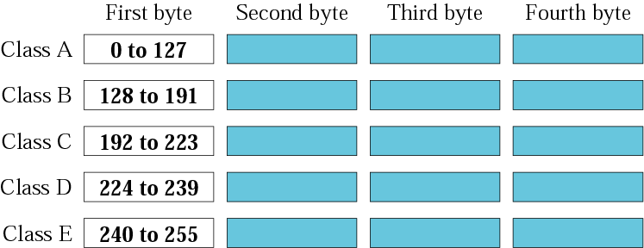
IPv4 Addressing (cont)
The network address is assigned to organization
The range of addresses can automatically be inferred from the network address
Finding the class in decimal notation
Fig 5.6 – Forouzan 4th edition
19

Slide 20
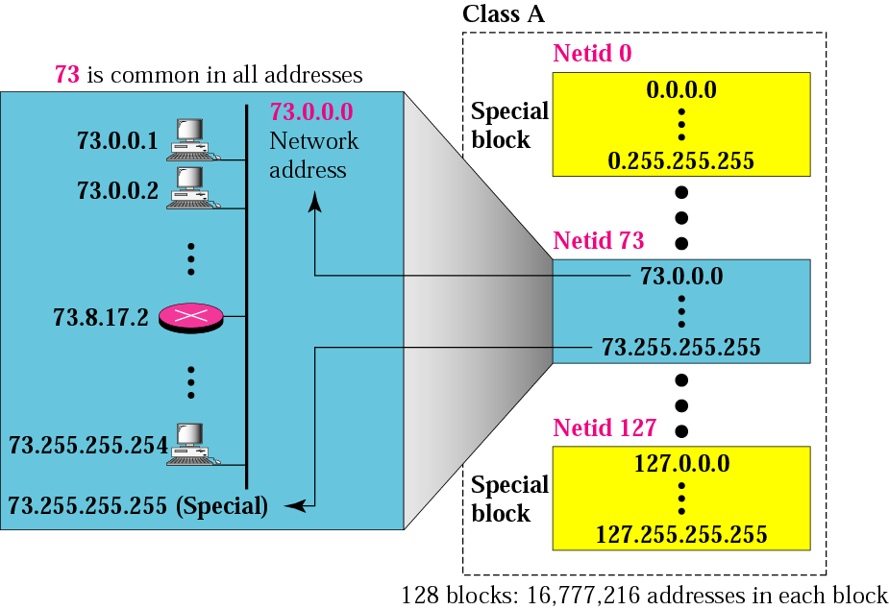
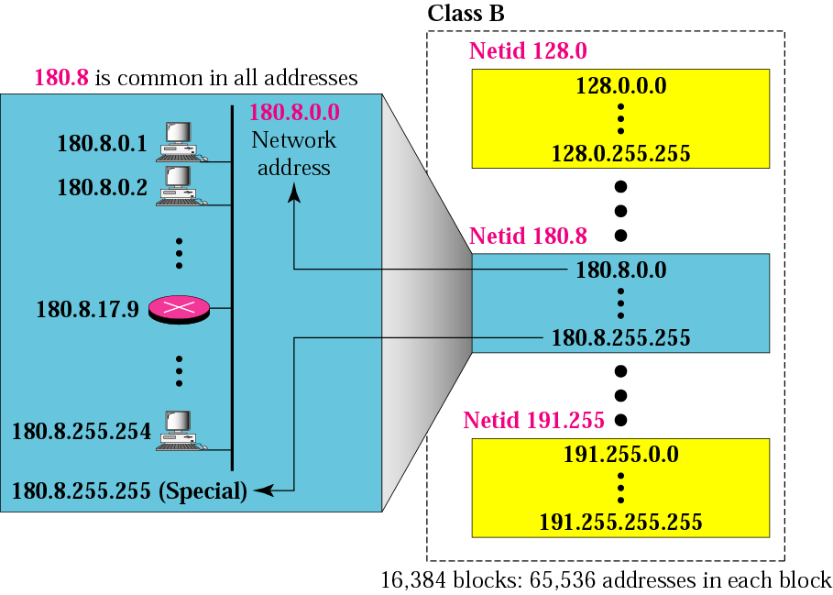

IPv4 Addressing (cont)
Blocks in class A
Blocks in class B
Blocks in class C
Fig 4.7 – Forouzan 3rd edition
Fig 4.8 – Forouzan 3rd edition
Fig 4.9 – Forouzan 3rd edition
20

Slide 21
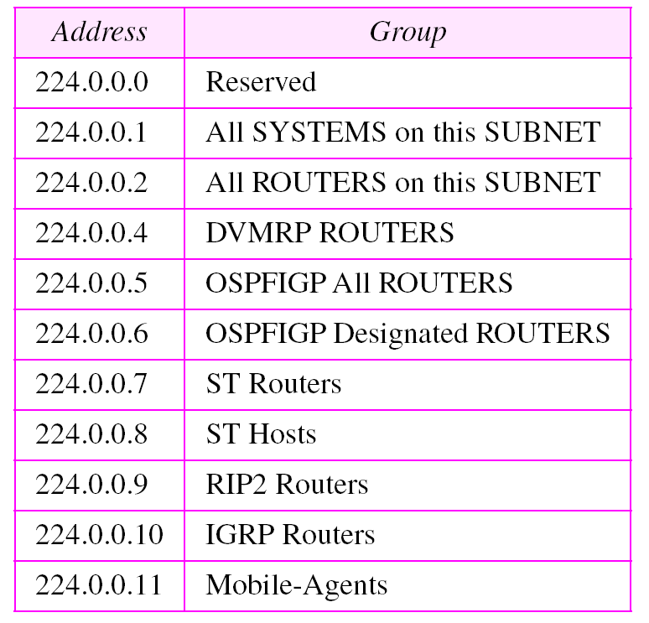
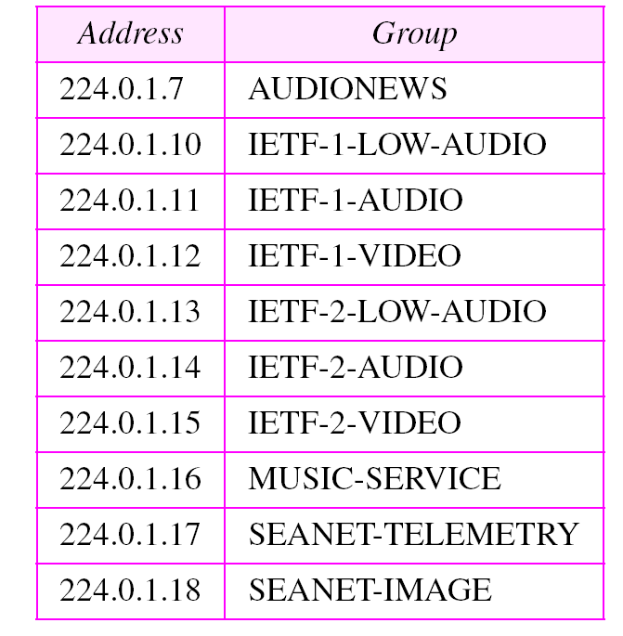
IPv4 Addressing (cont)
Multicast addresses
Category addresses
Addresses for conferencing
Table 4.5 – Forouzan 3rd edition
Table 4.6 – Forouzan 3rd edition
21

Slide 22
Classless Addressing
Big problem related to IP addressing: ROADS (Running Out of Address Space)
Examples: exhaustion of class B address space and explosion of routing table growth triggered by a flood of new class C
Solution advanced by IETF: Classless Inter-Domain Routing (CIDR)
Today, we have therefore two forms of IP addressing
Classfull addressing: N (Prefix and Netid) is constrained to 8 or 16 or 24 bits only [RFC 1700 and RFC 1117]
Classless addressing: N can be any number of bits, up to 30 [RFC 1518 and RFC 1519]; used in CIDR
Accordingly, CIDR dotted decimal representation is in the form xxx.yyy.zzz.vvv/ww, where ww indicates the number of leading bits in the 32-bit IP address that constitute the “Network” portion (example 223.1.1.0/24)
Classful addressing is a special case of classless addressing
22

Slide 23
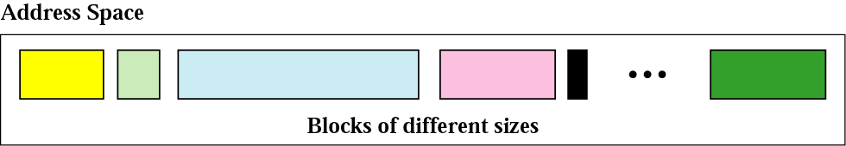
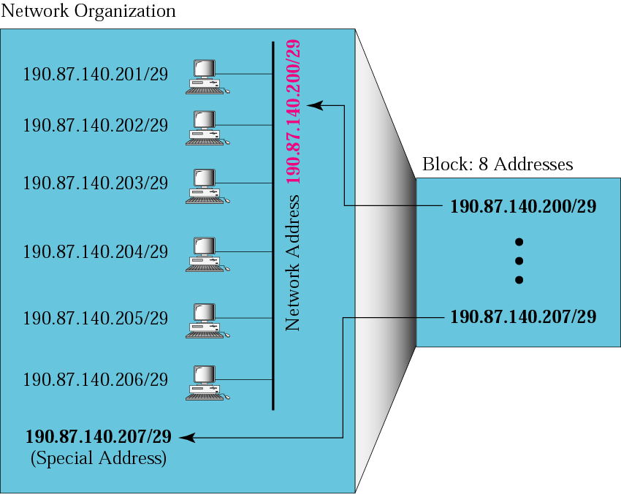
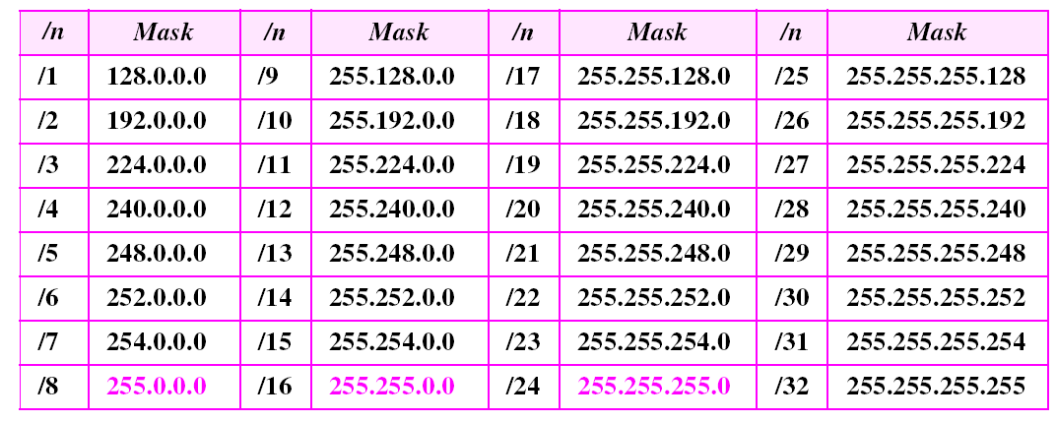
Classless Addressing (cont)
Example
Prefix lengths
Fig 5.5 – Forouzan 3rd edition
Table 5.1 – Forouzan 3rd edition
23

Slide 24
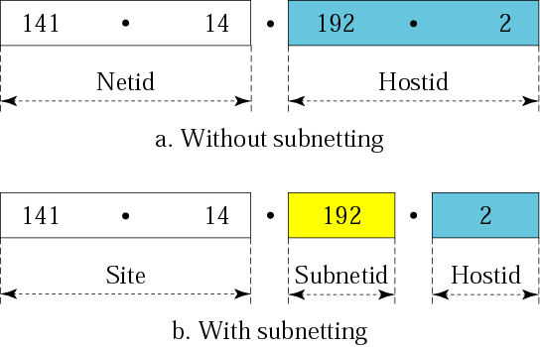
Subnetting and Supernetting
A third hierarchical level was introduced in 1984 in the addressing structure, namely subnet
The address format is therefore: Prefix/Network/Subnetwork/Host
The Subnet field can be of any length and it is specified by a 32-bit mask
The IP addresses are therefore designed with two levels of hierarchy
One determines that an address belongs to a subnet by a ”comparison-under-mask” operation (bitwise AND)
The effect of the Subnet Mask is to erase the portion of the Host field, so leaving only the Network number and the Subnetwork number
Fig 4.22 – Forouzan 3rd edition
24

Slide 25
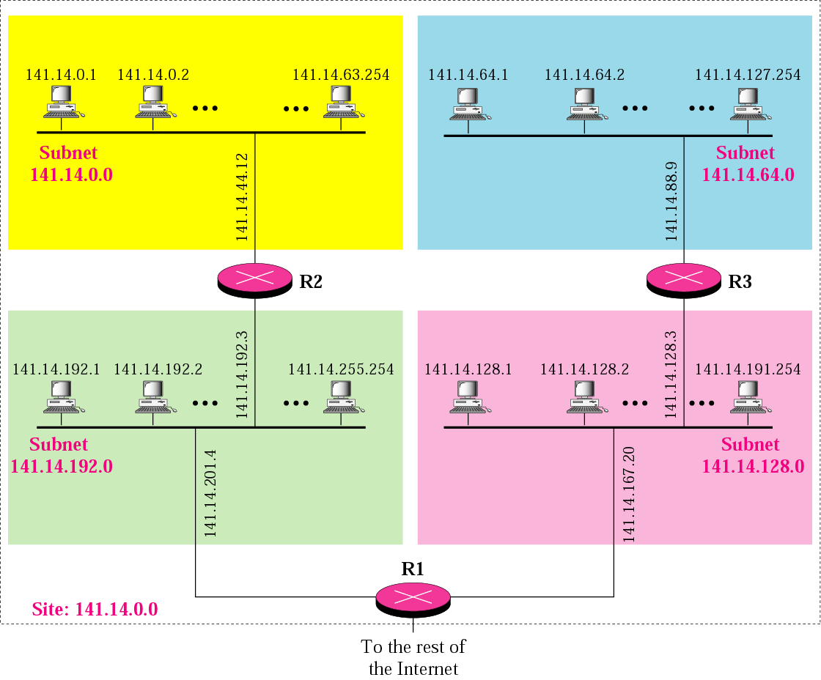
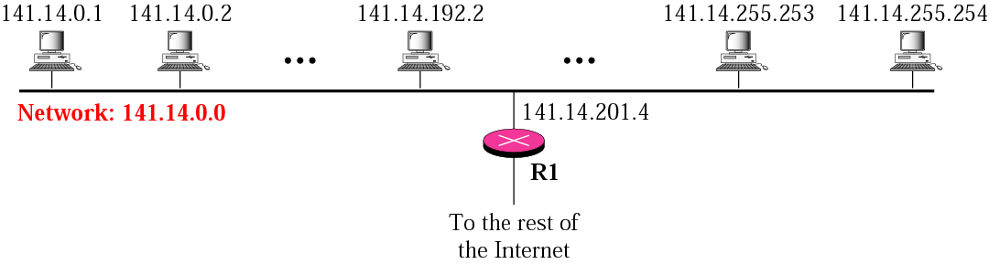
Subnetting and Suppernetting (cont)
A network with two levels of hierarchy (not subnetted)
Fig 4.20 – Forouzan 3rd edition
A network with three levels of hierarchy (subnetted)
Fig 4.21 – Forouzan 3rd edition
25

Slide 26
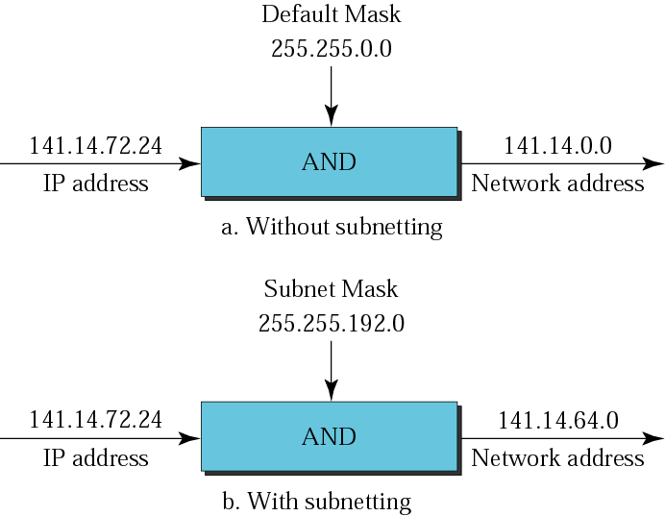
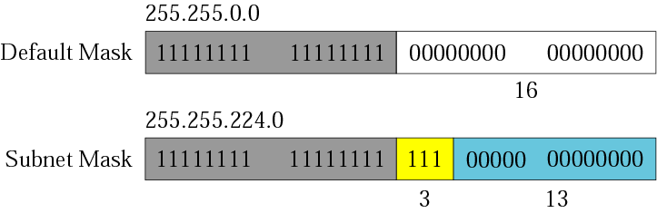
Subnetting and Suppernetting (cont)
Comparison of a default mask and a subnet mask
Default mask and subnet mask
Fig 4.25 – Forouzan 3rd edition
Fig 4.24 – Forouzan 3rd edition
26

Slide 27
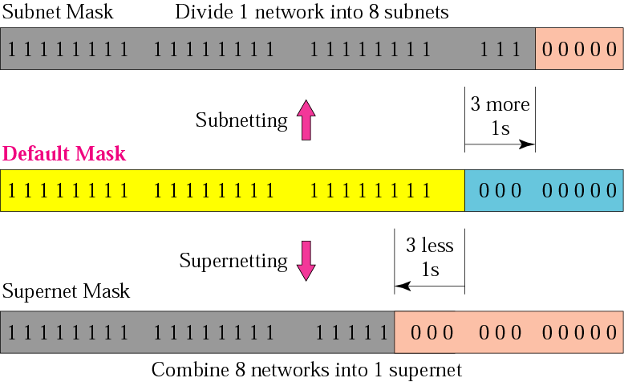
Subnetting and Suppernetting (cont)
In subnetting, one needs the first address of the subnet and the subnet mask to define the range of addresses
In supernetting, one needs the first address of the supernet and the supernet mask to define the range of addresses
The idea of subnetting and supernetting of classful addresses is almost obsolete
Comparison of subnet, default and supernet masks
Fig 4.27 – Forouzan 3rd edition
27

Slide 28
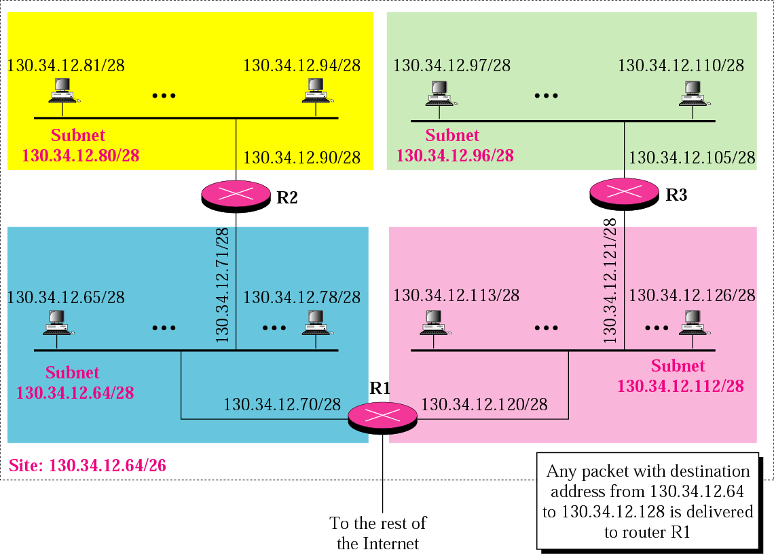
Subnetting and Suppernetting (cont)
Example of subnetting
Fig 5.6 – Forouzan 3rd edition
28

Slide 29
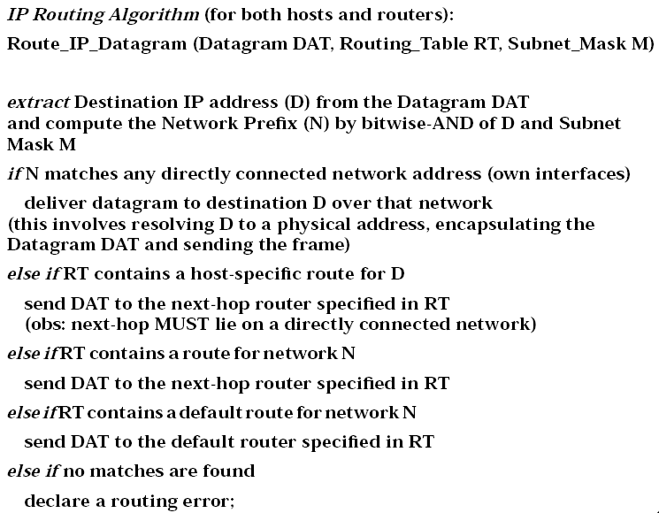
Datagram Delivery
29

Slide 30
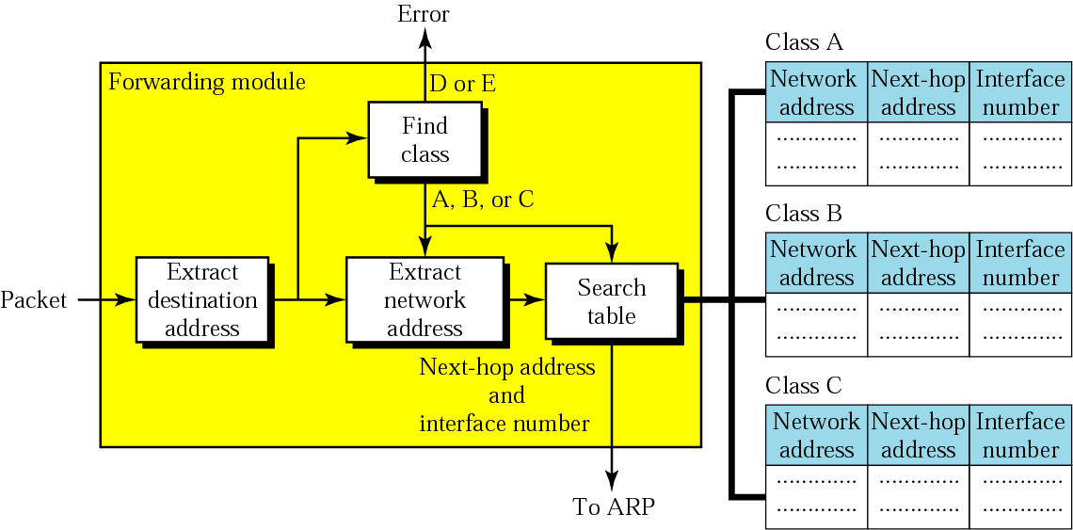
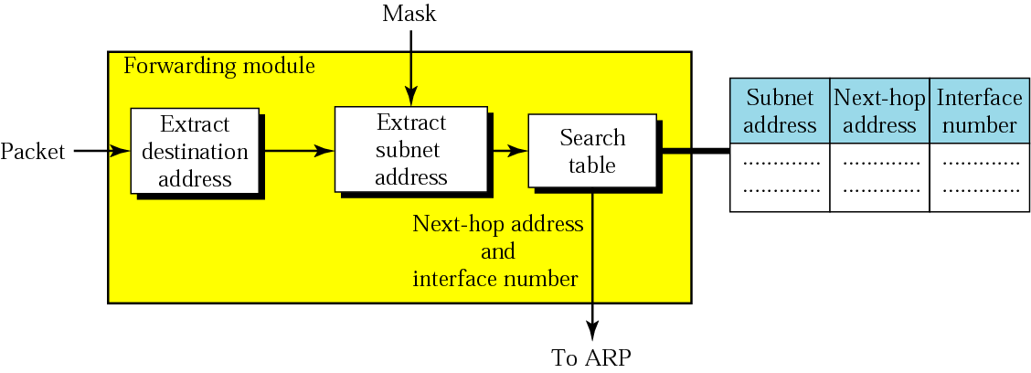
Datagram Delivery (cont)
Simplified module for forwarding in classful address with subnetting
Simplified module for forwarding in classful address without subnetting
Fig 6.10 – Forouzan 4th edition
Fig 6.7 – Forouzan 4th edition
30

Slide 31
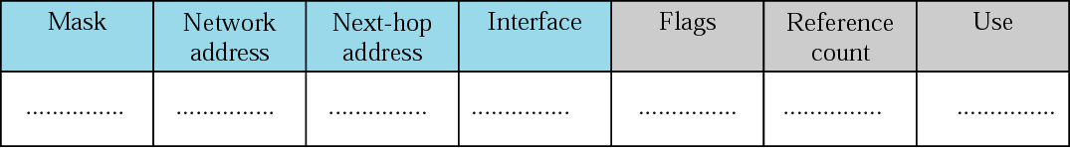
Datagram Delivery (cont)
In classful addressing, one can have a routing table with three columns
In classless addressing, one needs at least four columns
Common fields in a routing table
Fig 6.18 – Forouzan 3rd edition
31

Slide 32
Finding the Local Router
Question: what to do when there are more routers in a network, and not one? To which router send the datagram?
Another question: how to learn the addresses of these routers?
Discovery procedures are used to answer these questions
Discovery procedures
Static (system manager, difficult)
Dynamic, by using ICMP messages of type advertisements and solicitations
Advertisements are broadcasted by the routers to the Internet (every 7th minute)
Solicitations: the hosts may trigger the emission of these messages
32

Slide 33
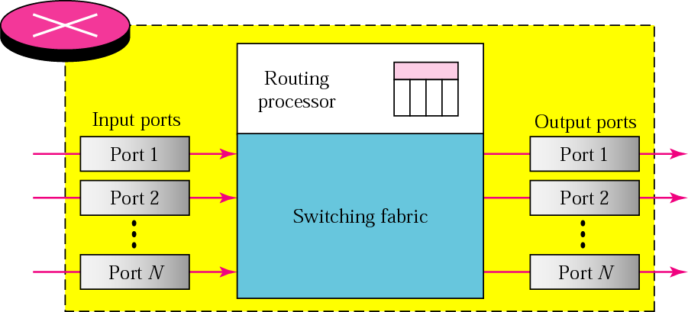
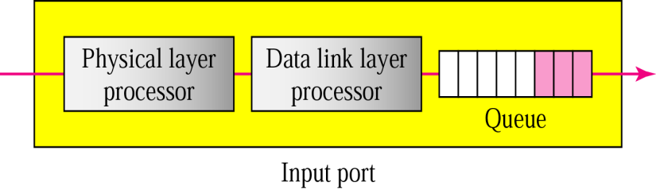
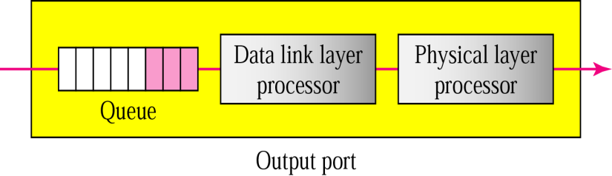
Routers
Router components
Figs 6.22, 6.23 and 6.24 – Forouzan 4th edition
33

Slide 34
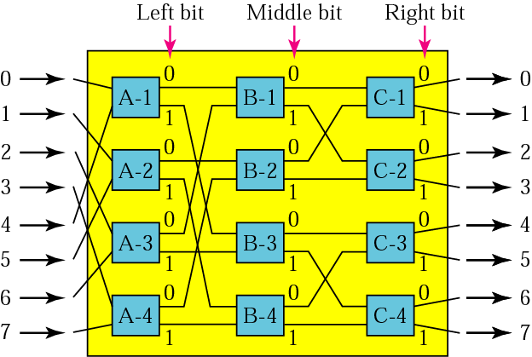
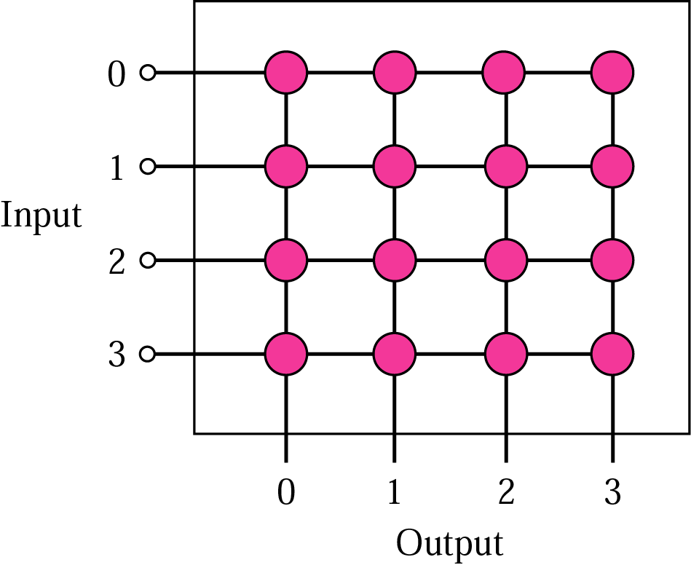
Switches
Banyan switch
Crossbar switch
Figs 6.25 and 6.26 – Forouzan 4th edition
34

Slide 35
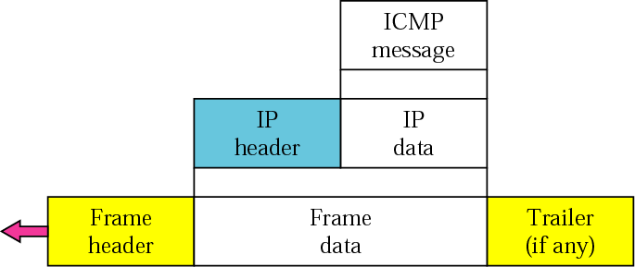
ICMPv4
Used by hosts, routers and gateways to communicate information to each other, mostly for signaling/diagnostic error conditions; it provides feedback information about network problems [RFC 792]
Most ICMP messages are diagnostic information that is sent back to the source when a router destroys a packet, e.g., when the routing can not be solved (destination unreachable) or when TTL expires (time exceeded) or when a router detects a congestion (source quench)
ICMP also defines an echo function that can be used for testing connectivity (ping)
ICMP is considered as part of IP but architecturally it lies just above IP, as ICMP messages are carried inside IP datagrams
Software that are using ICMP: ping, traceroute
ICMP encapsulation
Fig 9.2 – Forouzan 4th edition
35

Slide 36
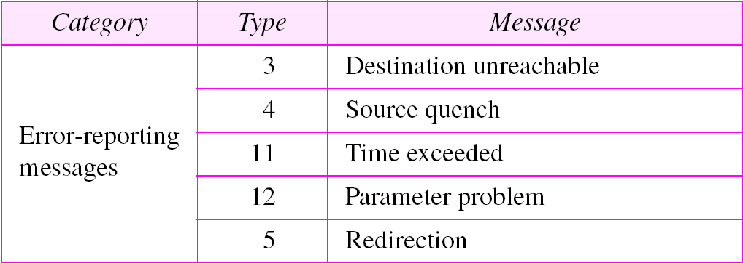
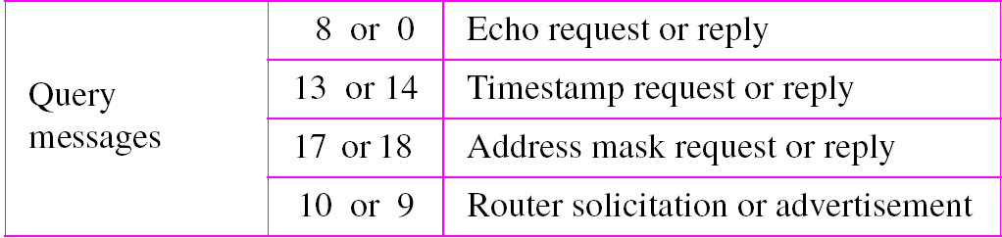
ICMPv4 (cont)
Two categories of ICMP message
Error-reporting messages: to report problems that a router or destination host may encounter
Query messages: to get specific information from a router or another host
ICMP messages
Table 9.1 – Forouzan 4th edition
36

Slide 37
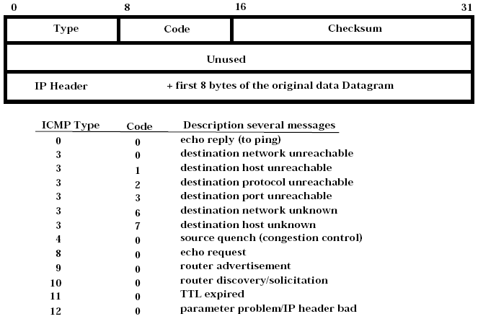
ICMPv4 (cont)
ICMP messages have the format Type/Code/Checksum and also contain the first eight bytes of the IP datagram (together with the Header) that caused the ICMP message to be generated in the first place, such as the sender can determine the packet that caused the error
37

Slide 38
Address Translation
Translation between IP and MAC address
Address Resolution Protocol (ARP) IP to MAC [RFC 826]
Reverse Address Resolution Protocol (RARP) MAC to IP [RFC 903]
ARP lies architecturally bellow IP, as ARP/RARP messages are carried inside MAC frame (as payload)
Variants of ARP/RARP have been defined for different networking technologies, e.g., Ethernet/IEEE 802.3, Token Ring/IEEE 802.5, FDDI, etc
Programs that use ARP: arp (comment: this is an Ethernet broadcast)
Lists of IP/MAC are in Proxy ARP memory (routers/gateways) and ARP cache memory (hosts)
38

Slide 39
References
Forouzan B.F,”TCP/IP Protocol Suite”, 4th edition, McGraw-Hill, chapters 4, 5, 6, 7, 8, 9, 18
Other useful addresses
39

Slide 40

THANK YOU!
40

